Slide 1
Project Proposal Course: Intro to UAV design
Saurabh B. Mishra (2023702023), MS in ECE
Rohan Gupta (2020112022), ECD

Slide 2
Objective
Trajectory and/or motion control of UAV
Following a specific trajectory smoothly and quickly
Minimum two trajectory
Mathematical modelling of the related framework
Coordinate system with reference frame
Inertial frame
Dynamics
We will try to optimize performance compared to mainstream techniques.
We will present one real world application of our project: with zero yaw rate.
We will use some specific functions for motion and/or trajectory planning.

Slide 3
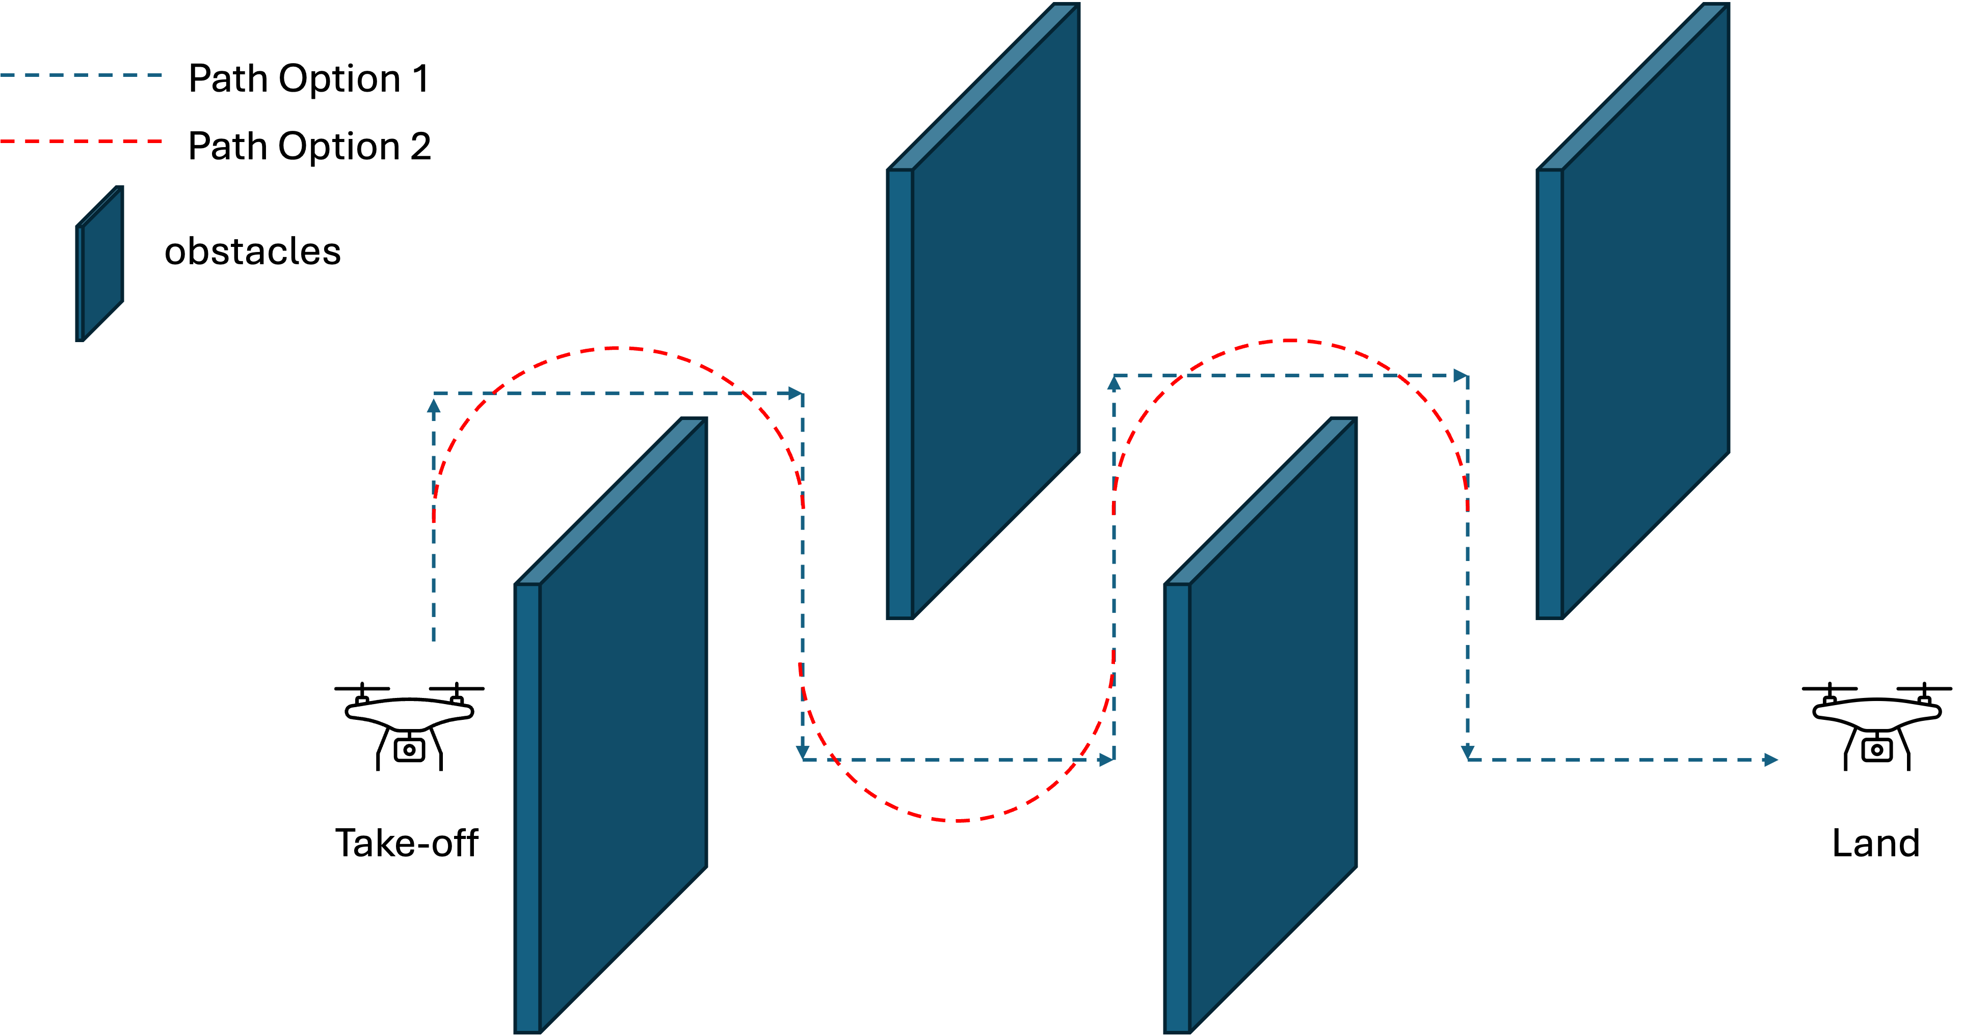
Problem definition
Challenges for a multirotor for indoor setting is because of
Higher order vehicle dynamics
Limited free spaces through the environment
To design multirotor UAV that is able to
navigate through indoor environment
avoiding obstacles encountered along the path in real time.

Slide 4
Design specifications
State estimation
Mapping
Path planning
Path relocation
Obstacle free path finding
Trajectory generation and optimization
Trajectory tracking
What we are proposing for the project

Slide 5
Related work
Arshad, Muhammad Awais, Jamal Ahmed, and Hyochoong Bang. 2023. "Quadrotor Path Planning and Polynomial Trajectory Generation Using Quadratic Programming for Indoor Environments" Drones 7, no. 2: 122.
Motion planning framework
Path Planning and Control of an Autonomous Quadrotor Testbed in a Cluttered Environment https://doi.org/10.33915/etd.5313

Slide 6
Deliverables for Design and simulation
At current stage
ROS
MATLAB code for
Multi-rotor PD controller
Algorithms for path planning
Trajectory optimizations: acceleration trajectory

